Slide 1
Network Security
Performance Comparison of the state of art Block and Stream ciphers over TCP/UDP protocols for different types of wired/wireless networks, and applications.
By Talha Abdullah

Slide 2
Project Goals and Objectives
Establish a UDP/TCP Protocol
Compare the performance of block ciphers and stream ciphers over the established protocol using known ciphers such as AES and RC4
Compare the Error tolerance for block cipher and stream cipher
Compare the Performance based on Error tolerance
Brief positive sides of the block cipher and stream ciphers

Slide 3

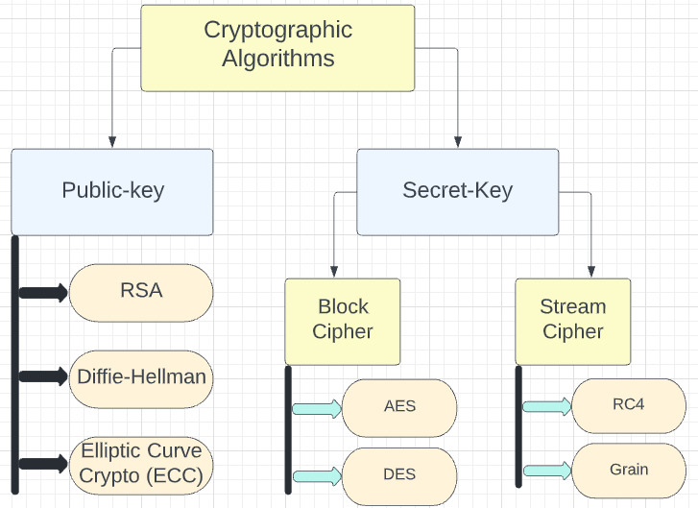
Classification of Cryptographic Algorithms

Slide 4
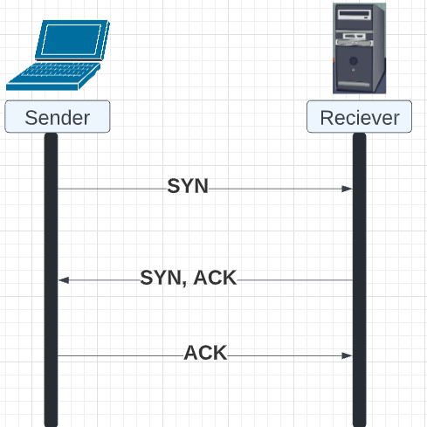
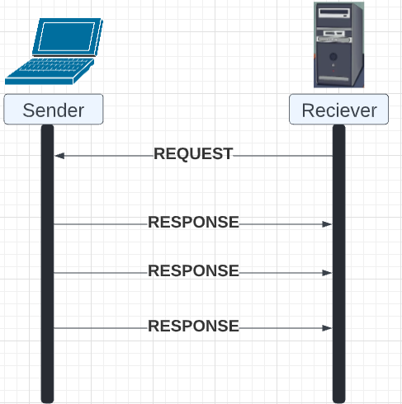
TCP vs UDP
TCP Schema
UDP Schema

Slide 5
TCP vs UDP – Error Expectancy
TCP retransmits lost data, hence error in TCP is almost zero
UDP does not retransmit packets that is lost or corrupted
UDP is more prone to errors than TCP

Slide 6


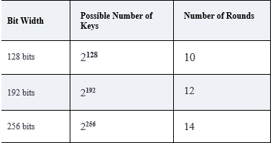

Block Cipher AES Algorithm
Advanced Encryption Standard (AES)
Unbreakable symmetric encryption
Blocks are processed of fixed 128 bits size.
Different bit sizes of key length results in 2^n number of keys as well as different number of Rounds.

Slide 7
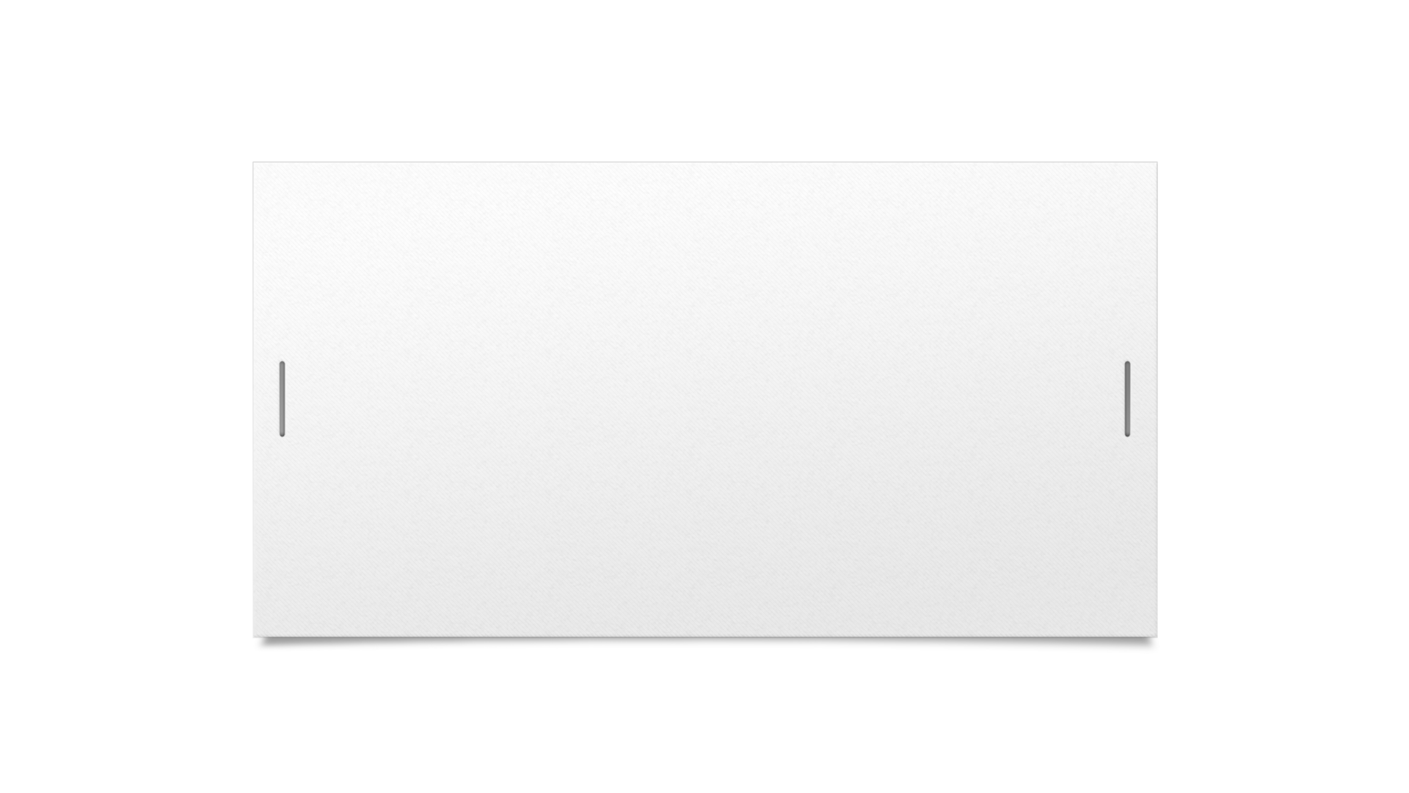
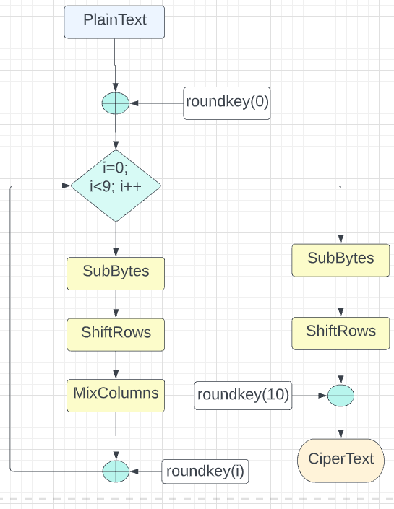

Block Cipher AES Algorithm
Plaintext is processed in blocks
First 9 rounds involve SubBytes, ShiftRows, MixColumns, Add round key
Last round involves SubBytes, ShiftRows, Add Round key
Ciphertext is achieved in blocks

Slide 8
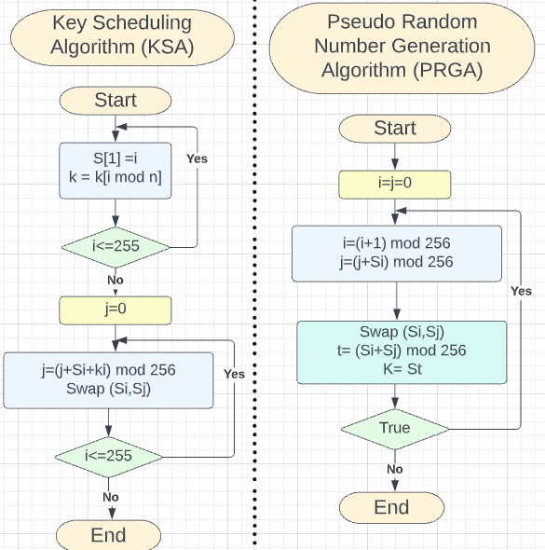
Stream Cipher RC4
One of the most widely used stream ciphers till today
Key Scheduling Algorithm (KSA)
Pseudo Random Number Generation Algorithm (PRGA)

Slide 9
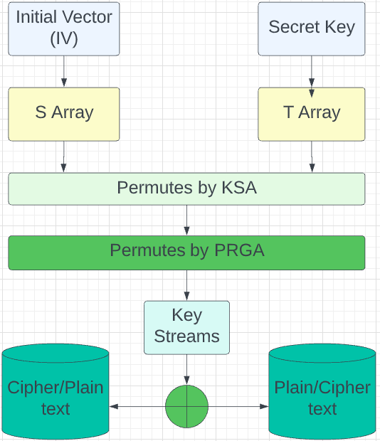
Overview of RC4

Slide 10
Error Tolerance for the System AES vs RC4
TCP
Block Cipher (AES) : Zero Probability of errors
Stream Cipher (RC4) : Zero Probability of errors
UDP
Block Cipher (AES) : Error Tolerance is lower compared to RC4 (Blocks are affected)
Stream Cipher (RC4) : Error Tolerance is higher (errors are localized)

Slide 11
When to Use?
Block Cipher – When Security matters, block ciphers are preferred
Stream Cipher - Faster and Efficient (Devices with fewer resources)

Slide 12

Results of Implementation
For TCP
Stream cipher and Block cipher result in the same image that is a clear and precise image

Slide 13
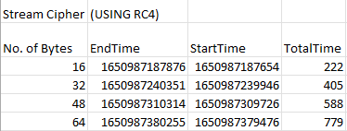
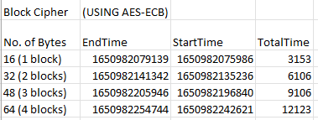
Time Taken by Stream Cipher and Block Cipher Over TCP
Block Ciphers (AES) take Comparatively more time (in milli Seconds) than Stream Ciphers (RC4) for the same number of bytes over the TCP Protocol

Slide 14
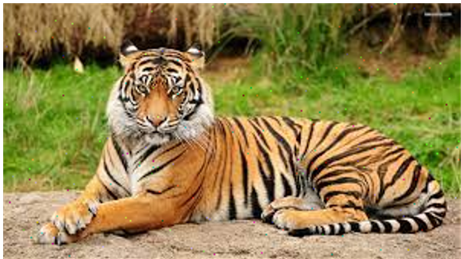
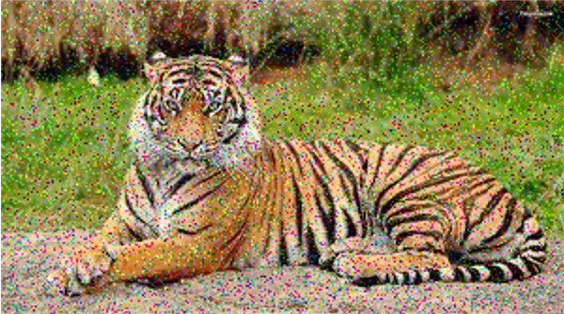
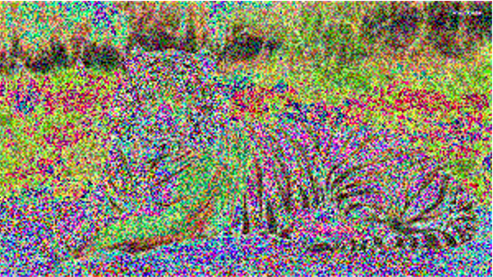
For UDP (Stream Cipher)
Threshold=0.01 Threshold=0.1 Threshold=0.5

Slide 15
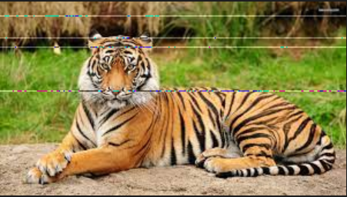
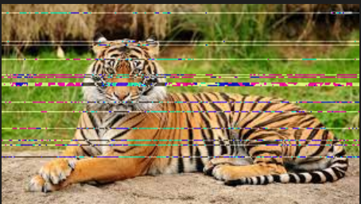

For UDP (Block Cipher)
Threshold=0.01 Threshold=0.1 Threshold=0.5

Slide 16


